Slide 1
GLOBAL SUICIDE RATES
By
Estrella.

Slide 2
Introduction
Suicide is often a gloomy and morbid topic that we often shy away from.
There are various reasons (often personal) that drive people towards this act.
The campaign for Mental Health Awareness is no longer fought behind closed doors.

Slide 3



THE TEAM: ESTRELLA
Notes:
This presentation was analysed and prepared by Estrella a group of 3 data ambitious data scientists. Hosea, Ruth & Allan as the team lead.

Slide 4

Let’s talk ...
Globally, close to 800,000 people die from suicide every year. That’s one person every 40 seconds.
Some countries have even rendered suicide as illegal.
Thus, people shy away from speaking out and even reporting these cases.

Slide 5
Assessing the situation
Resource Inventory:Datasets: Suicide Rates Overview 1985 to 2016 - [Link]
Software: Github, Google Collaboratory, Trello)
Assumptions: The data provided is correct and up to date
Notes:
This project relies on the following tools and resources.

Slide 6
Research objectives
Finding the country with the highest suicide rates
Understanding which generation has the highest suicide rates
Investigating which gender has more suicide rates compared to the other one
Knowing the age which most people commit suicide
Finding out the year where people committed suicide the most
Notes:
The following constitute the primary reason driving this research;

Slide 7
Success criteria
Achieve the objective insights surrounding the suicide topic.
Answer all the research questions and objectives with the insights primarily gotten from the data analysis.
Notes:
We will mark the success of our project based on the following metrics;

Slide 8
Data understanding (Overview)
This project uses data retrieved from Kaggle.
The main overview of the dataset is that it compares the socio-economic info with suicide rates by year and country.
The data will be mainly cleaned and analyzed using Python Pandas and SQL.
Notes:
The dataset contains the data from 1985 to 2016.
It consists of 12 columns and 27,820 rows.

Slide 9
Data Preparation
We looked for outliers, ensured the validity, uniformity, completeness, accuracy and consistency were upheld.
Some columns were dropped e.g ‘Country-Year.’
Another variable (‘HDI for year’) was also dropped as it added no value to our insights.
There was also no duplicated data. Therefore, the data was passed as consistent.
Notes:
Before we embarked on the analysis of our data, we first cleaned out our data.
Some columns were dropped that include ‘Country-Year.’ The reason is that this column was simply a merge from the ‘country’ and ‘year’ columns.

Slide 10
Data preparation (Cont.)
The ‘gdp_per_year ($)’ column was renamed to gdp_per_year and its datatype converted from string to float.
The syntax errors including the commas in the numeric values were removed.
The gdp_per_capita ($) column was renamed to gdp_per_capita.

Slide 11
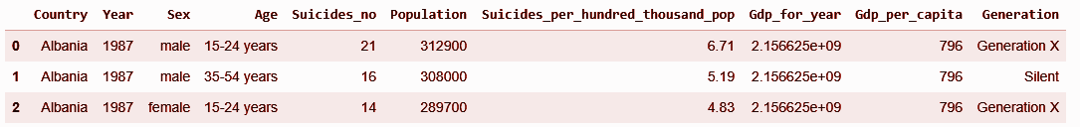
The Dataset
After cleaning, the dataset that we used for the analysis was as follows:
Notes:
This is a snippet of the first three rows. The columns are all included.

Slide 12
Outliers
Outliers usually tend to skew the data and result into unreliable conclusions and recommendations.
With respect to our data, we removed outliers from the suicide numbers, GDP for the year, and the GDP per capita outliers.
Notes:
In any dataset, we ought to look out for outliers.

Slide 13
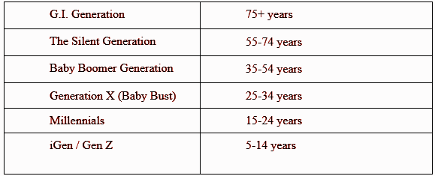
Analysis and Insights
The generations are grouped as:
Notes:
Before we go ahead to show the insights we got from our data, we need to familiarize ourselves with this chart:

Slide 14
Finding the country with the highest suicide cases
Bulgaria reports the highest number of suicide rates in the world having 31,114 cases.
Other leading countries include;
Hungary 30122 cases
Chile 30111 cases
Notes:
Looking for the country with leading suicide cases helps us focus on that specific country and investigate the reasons leading to this occurence.

Slide 15
2. Finding the country with the lowest suicide cases
Notably, Dominica and Saint Kitts and Nevis were excluded from the list as they had 0 cases.
San Marino 1 case
Antigua and Barbuda 11 cases
Maldives 20 cases
Qatar 23 cases

Slide 16
3(a). Identifying the generation with the highest suicide rates on Overall
The list, in descending order is as follows;
Silent 68.981965
G.I. Generation 48.559870
Generation X 41.461185
Boomers 36.591157
Millenials 18.740245
Notes:
Analysis on generation is particularly helpful as it shows those mostly affected by this issue.
Silent generation had the highest cases whilst millennials reported the least cases.

Slide 17
3(b). Identifying the generation with the highest suicide cases before 2000
G.I. Generation 45.037588
Generation X 21.152026
Boomers 19.620954
Silent 17.476758
Millenials 0.738956
Millenials had the least suicide cases before 2000.
Notes:
The main aim of this insight is to find the suicide rates of the generations prior to the Gen Z prop.

Slide 18
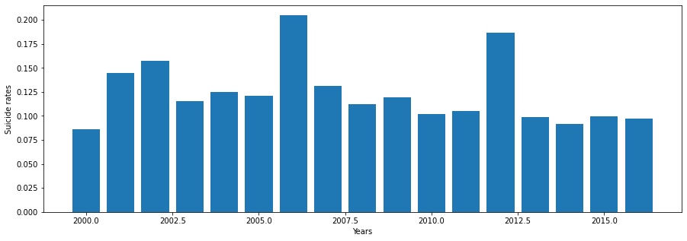
3(c). Identifying the trend of suicide cases after 2000
Notes:
The suicide cases peaked during 2006 and 2012.

Slide 19
4. Identifying the generations with the lowest suicide cases on overall
Generation Z 0.694169
Millenials 18.740245
Boomers 36.591157
Generation X 41.461185
G.I. Generation 48.559870
Gen Z has the least suicide cases overall and G.I. Generation had the highest number of cases.

Slide 20
5. Investigating which gender has more suicide rates compared to the other one on overall
male 498619
female 329940
The male gender tends to suffer more on suicide issues than females.

Slide 21
6. Finding out the year where people committed suicide the most on overall
1999 35636
2000 35279
2002 35128
2001 34769
1997 34544
There is no reliable source that explains this occurrence.
Some speculations however point out to the claim regarding the world ending around 2000.
Notes:
There is no reliable source that explains this occurrence. Some speculations however point out to the claim regarding the world ending around 2000.

Slide 22
7. Finding which countries has the most suicides committed at every 100,000 on overall.
Lithuania 8091.18
Latvia 7264.59
Suriname 7162.32
Slovenia 7012.62
Estonia 6873.78
Lithuania has the highest rates at every 100,000 population.

Slide 23
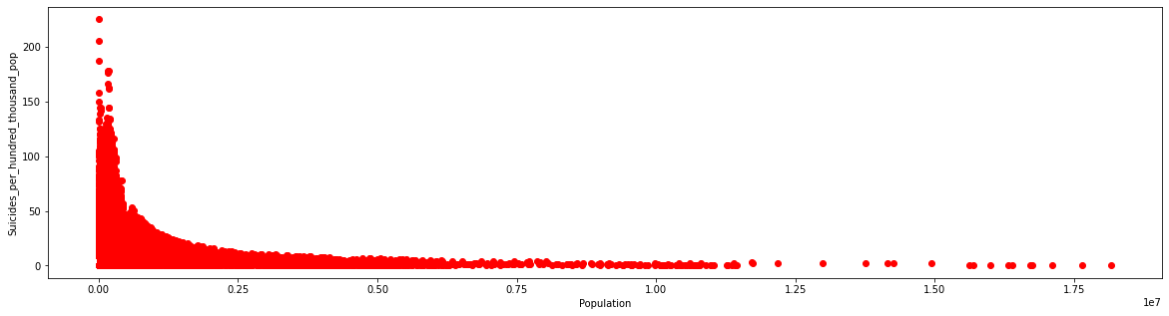
8. Impact of Population on Suicide Rates (per 100,000)
A plot for the Suicides per 100,000 against Population
Notes:
The lower the population, the higher the suicide per 100,000 cases.

Slide 24
9. Countries with the least suicides committed at every 100,000 on overall.
Russian Federation 10.52
Oman 26.50
Qatar 27.30
San Marino 47.26
Notes:
This list has excluded Dominica and Saint Kitts and Nevis as they have no reported suicide cases.

Slide 25
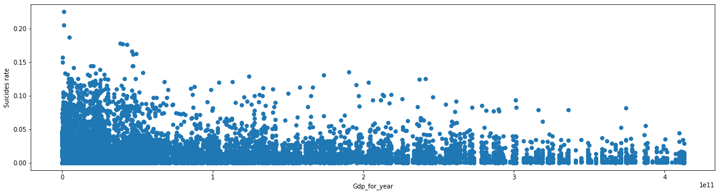
10. How does GDP affects suicide rates?
A plot for the suicide rates against Gdp for year for the countries.
Notes:
The lower the GDP, the higher the suicide rates. This has various outliers. However, it shows a general trend.

Slide 26
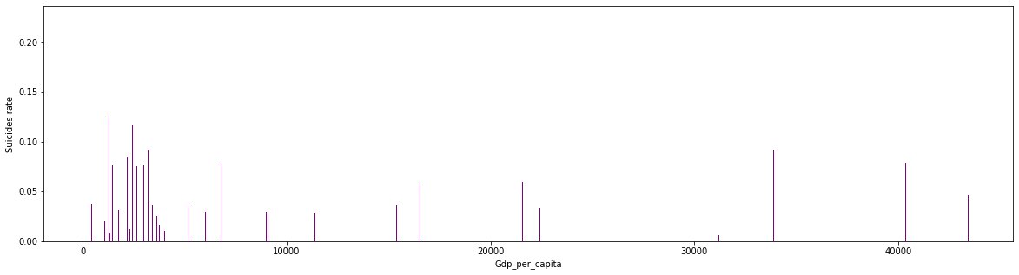
11. How does the GDP per capita impacts suicide rates?
A plot for the suicide rate against the Gdp per capita
Notes:
The general trend is that the lower the GDP per capita, the higher the suicide rates.

Slide 27
evaluation
European and Latin American countries lead in the number of global suicide cases.
Older generations (Silent and G.I. Generations) lead in the number of reported suicide cases in the world.
Males have high suicide cases than their female counterparts.

Slide 28
Evaluation (Cont.)
4. Low populations report high suicide rates and vice versa is also true.
5. The lower the GDP of a country, the higher the reported suicide rates

Slide 29
Recommendations
Governments need to be more proactive on matters pertaining to mental health and suicide-related incidences.
More attention should be directed to the older generations and ensure that their emotional, physical and mental aspects are upheld.
There should be a widespread sensitization that targets males regarding the importance of seeking external help and support.

Slide 30
Recommendations (Cont.)
Countries with a low population needs to put measures in place that protects its citizens from suicide-related cases.
Governments with lower GDPs need to have some economic programs that will improve the standards of living of its people and thus, enhance their social needs and welfare.

Slide 31

THANK YOU FOR YOUR TIME!

